Slide 1
Create an Image Registry and a Knowledge Base of OpenShift Migration Issues for MOC Users
Vivek Shakya, MOC ,Co-op Spring 2020

Slide 2
What is required for migration ?
Setup OpenShift Container Platform 4.3 cluster on RedHat Openstack Platform
Install Cluster Application Migration(CAM) tool on both the clusters(3.11 and 4.3)
Backup Object Storage (AWS S3, GCP ,Azure, Generic S3)

Slide 3
Setup OpenShift 4.3 Cluster on Openstack
Obtain the installation program from here
Generate the clouds.yaml file which is used by installation program to access the openstack platform to create resources ( refer this link)
Generate the Install-config file based on our openstack environment
Create the cluster based on the install-config file
Configure the identity providers for user access

Slide 4
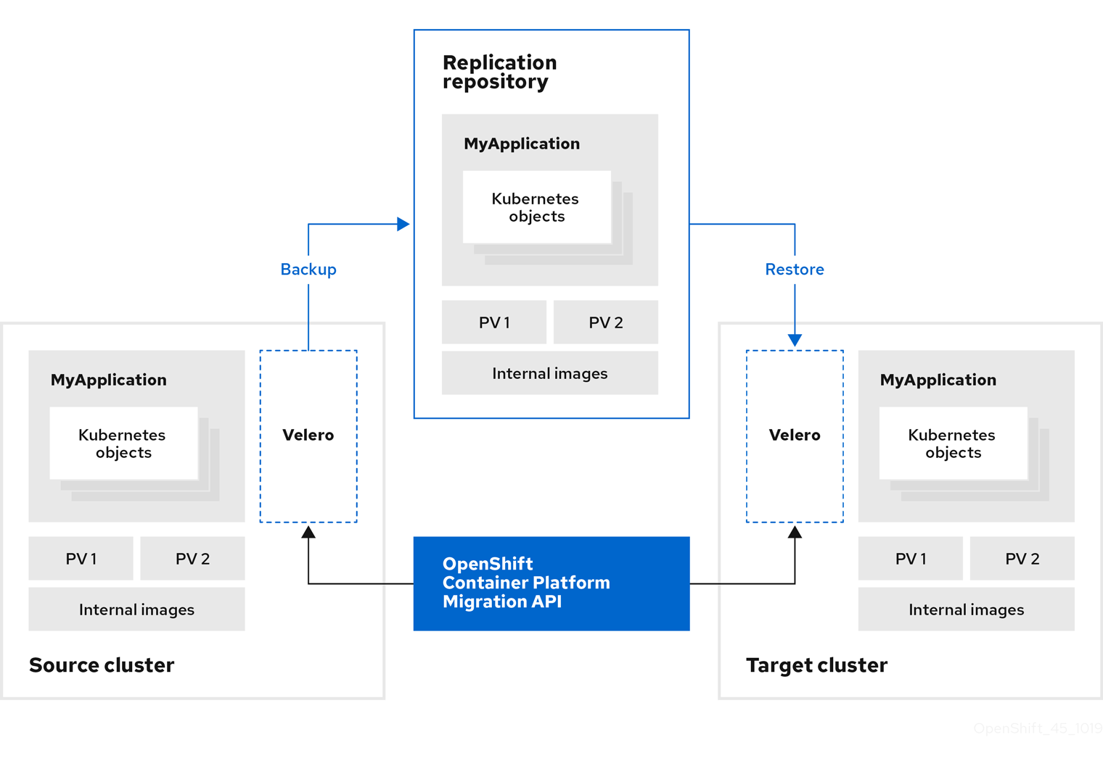
Overview of Migration using CAM tool
S3 object storage
PV - Persistent Volume is a cluster-wide resource that you can use to store data in a way that it persists beyond the lifetime of a pod
Velero- backup and restore your Kubernetes cluster resources and persistent volumes
Openshift 3.11 cluster
Openshift 4.3 cluster

Slide 5
Overview of migration continued ...
Install the Cluster Application Migration Operator on all clusters.
Configure the replication repository, an intermediate object storage that the CAM tool uses to migrate data.
Add the source cluster to the CAM web console.
Add the replication repository to the CAM web console.
Create a migration plan, with one of the following data migration options:
Copy: The CAM tool copies the data from the source cluster to the replication repository, and from the replication repository to the target cluster.
Move: The CAM tool unmounts a remote volume (for example, NFS) from the source cluster, creates a PV resource on the target cluster pointing to the remote volume, and then mounts the remote volume on the target cluster. Applications running on the target cluster use the same remote volume that the source cluster was using. The remote volume must be accessible to the source and target clusters.

Slide 6
Overview of migration continued ...
Run the migration plan, with one of the following options:
Stage (optional) copies data to the target cluster without stopping the application. Staging can be run multiple times so that most of the data is copied to the target before migration. This minimizes the actual migration time and application downtime.
Migrate stops the application on the source cluster and recreates its resources on the target cluster. Optionally, you can migrate the workload without stopping the application.

Slide 7
What could impact the applications during/after migration ?
Images used for the applications not supported on OCP 4.3
Applications may stop during migration, resulting in failed migration
Migration may fail due to restic timeout issues
Most cluster-scoped resources are not yet handled by the CAM tool. If applications require cluster-scoped resources, you may have to create them manually on the target cluster

Slide 8
Image tags removed from OCP 4.3
If your application uses images from the openshift namespace, the required versions of the images must be present on the target cluster.
The following imagestreamtags have been removed from OpenShift Container Platform 4.3:
dotnet:1.0, dotnet:1.1, dotnet:2.0
dotnet-runtime:2.0
mariadb:10.1
mongodb:2.4, mongodb:2.6
mysql:5.5, mysql:5.6
nginx:1.8
nodejs:0.10, nodejs:4, nodejs:6
perl:5.16, perl:5.20
php:5.5, php:5.6
postgresql:9.2, postgresql:9.4, postgresql:9.5
python:3.3, python:3.4

Slide 9
Manage imagestream
If the required images are not present, update the imagestreamtags references to use an available version that is compatible with the application
If the imagestreamtags cannot be updated, manually upload equivalent images to the application namespaces and update the applications to reference them.

Slide 10
Roll Back migration
Need for manually rolling back the migration could arise if a migration fails, the migration plan does not retain custom PV settings for quiesced pods
Procedure to rollback
On target cluster delete the deployed resources and update the PV’s reclaim policy
Update the nodeslector in the yaml to delete the daemonset

Slide 11
Create a knowledge base
Document the Installation issues and ways to mitigate them
Document the Migration process and issues encountered
Document the process to mitigate the migration issues
Look for tools to investigate which projects are using images that are not supported on OCP 4.3

Slide 12
Thank You

